Slide 1
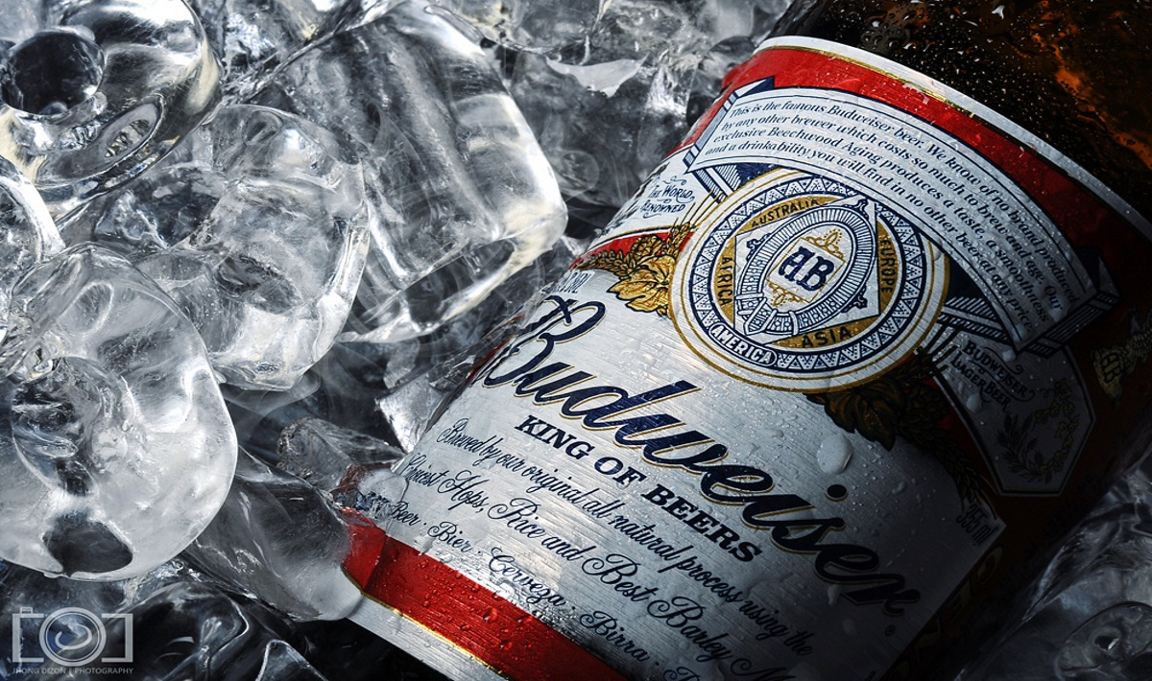
Beer and brewery Analysis
Adam Erganbrack
Emmanuel Opoku

Slide 2
Content
Business Case – To perform exploratory data analysis on beer information bitterness(IBU) and Alcohol Volume (ABV) by State and brewery
Data Acquisition – Beer data and Brewery data were obtained in CSV format
Data Preparation – Missing data was found using R and steps were taken to fill the gaps for missing values with 0
Data Visualization – Graphs were created using ggplot in R studio

Slide 3
Data Preparation
Total number of records
Beer Dataset: 2410 records
Brewery Dataset: 558 records
Following missing values were found:
Beer Dataset: IBU (1005 records), ABV (62 records), Style (4 records)
Missing values treatment:
Full-time Teachers (4 records) : Since we cannot tell the reason the values for the IBU and ABV are missing for some beer, we will replace those values with 0 since we do not want those records to be excluded from our exploratory Data Analysis

Slide 4
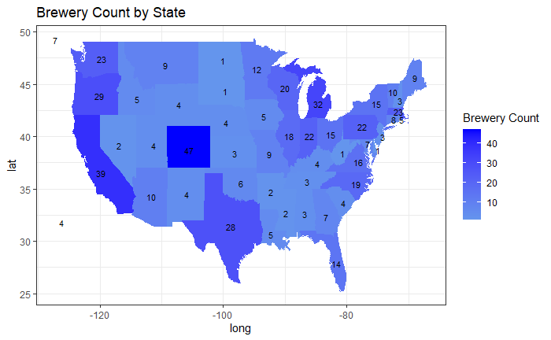
Number of breweries per State
Colorado has the highest number of breweries with 47
DC, WV, SD, and ND all have the least with 1 brewery each
NB: Please see the next slide for full list of breweries by state

Slide 5
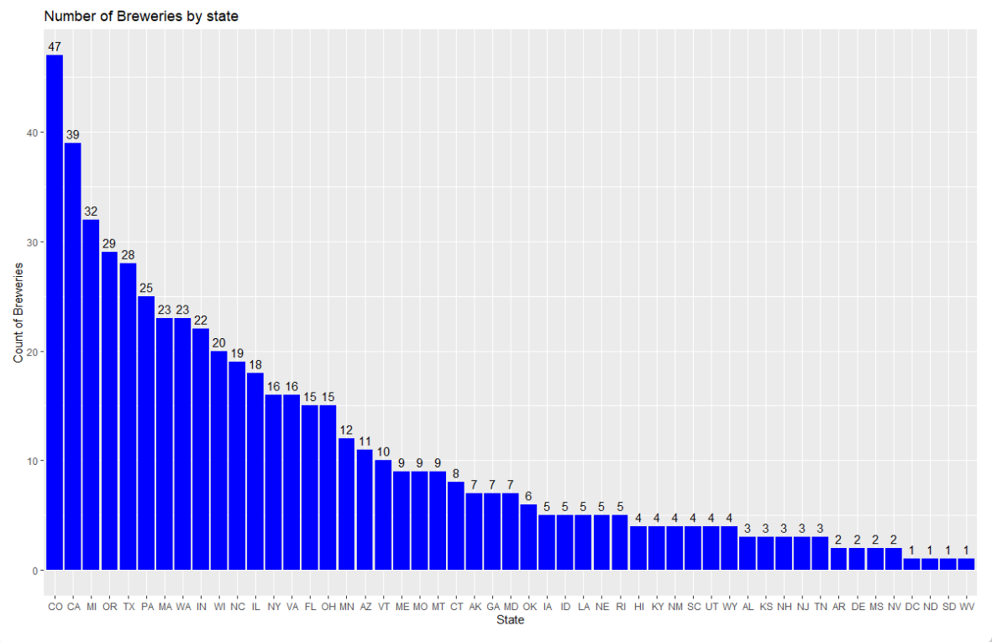
Number of breweries per State
Distribution of Breweries by State

Slide 6
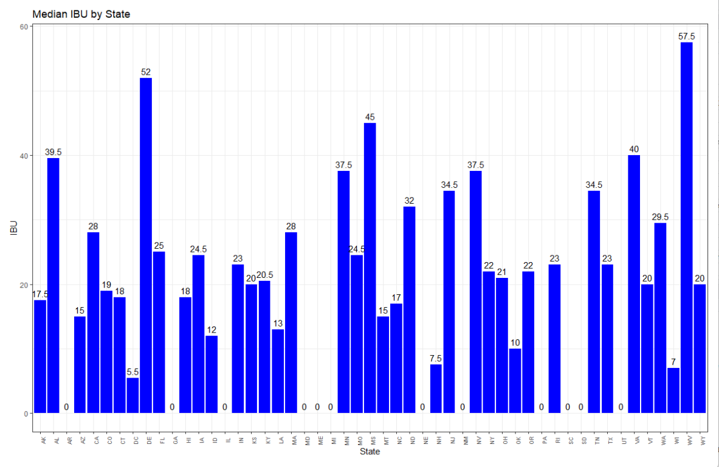
Median IBU (Bitterness) by State
Key Highlights
WV leads the pack in Median IBU with a level of 57.5 and followed closely by DE with a level 0f 52.
Multiple States have a median IBU of 0

Slide 7
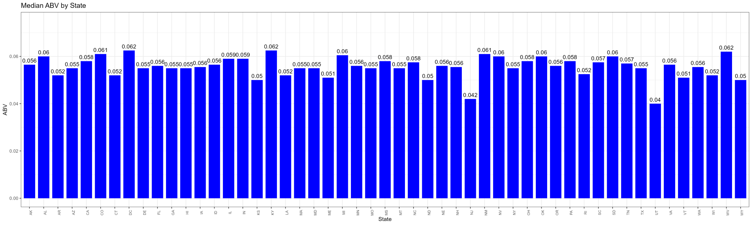
Median Alcohol Content (ABV)
Key Highlights
The median alcohol content looks to be fairly distributed across states for the most part of the data
No significant ABV outliers were detected

Slide 8
Other Interesting Findings
State with the maximum alcoholic( ABV) beer
District of Columbia (DC) and Kentucky (KY) tied with for the top spot with an ABV level of 0.0625 each
State with the most bitter beer. (IBU)
West Virginia has the most bitter beer with a median IBU level of 57.5

Slide 9
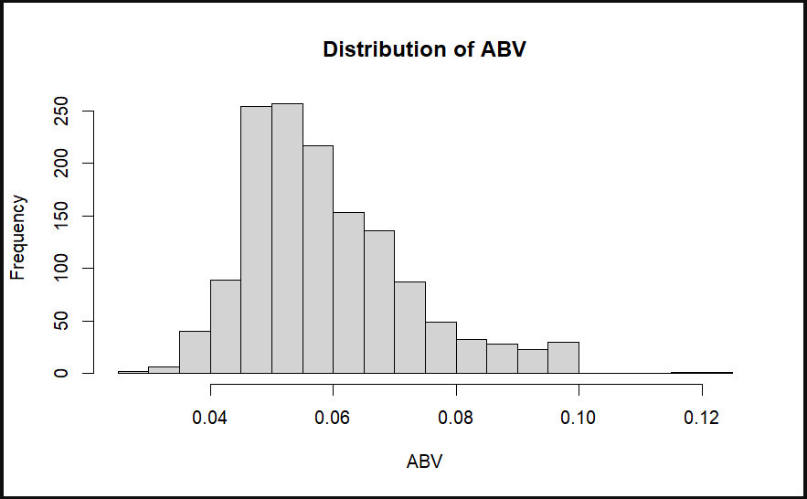
Summary Statistic and Distribution for ABV
Min. 1st Qu. Median Mean 3rd Qu. Max.
0.001 0.050 0.057 0.060 0.068 0.128
Key Highlights
The distribution for ABV across the data appears to be slightly normally distributed with most occurrences between 0.05 and 0.06

Slide 10
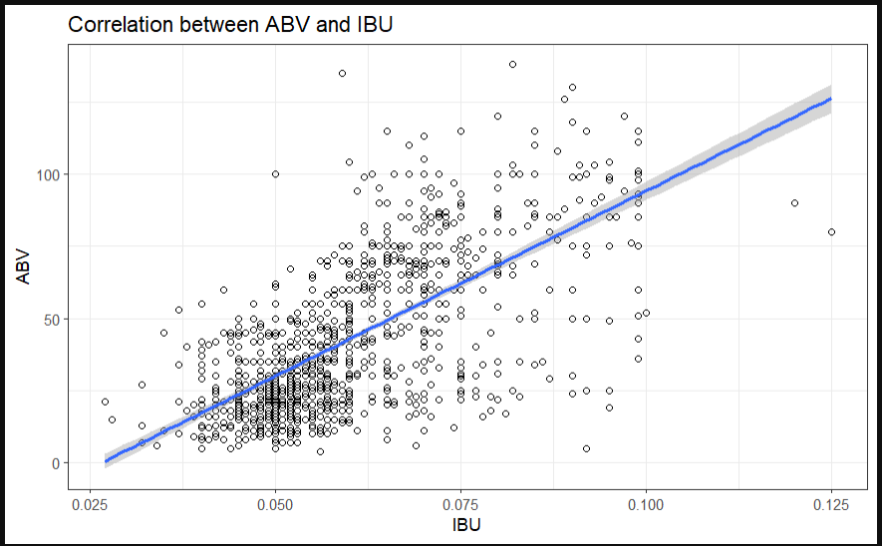
Relationship between IBU and ABV of Beers
Key Highlights
From the plot above, there is a positive correlation between and IBU. As the IBU of beers increase so does the ABV.
This point of view is confirmed further with the regression line included in the plot.

Slide 11
Questions?

